Slide 1

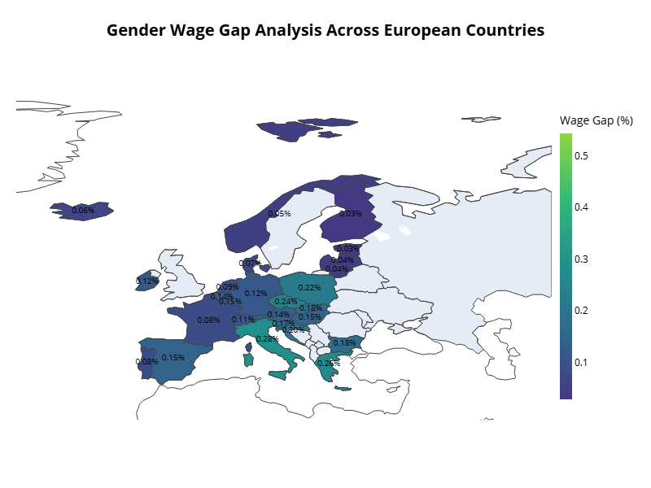
EXPLORING THE GENDER WAGE GAP IN EUROPE
Authors
Yumiko Maria Bejarano Azogue
Figure : Gender Wage Gap Analysis Across European Countries
Project Description
This project studies the gender wage gap in Europe using data from Eurostat and machine learning techniques. It looks at gender, age, and job type to find inequalities and help reduce them. The project uses data analysis to give ideas about fairer work practices.
Notes:
Hello everyone, my name is Yumiko Bejarano. In this presentation, I will talk about the Gender Wage Gap in Europe.
.
I studied the wage differences between men and women in Europe. I used data from Eurostat and machine learning to understand these differences. I also wanted to find ways to reduce these inequalities.
.
You can see... This map shows the gender wage gap across European countries. Darker colors mean a bigger wage gap.

Slide 2
INTRODUCTION
OBJECTIVES
The Capstone Project focuses on analyzing the Gender Wage Gap in Europe using Eurostat data and machine learning models to understand gender-based differences in employment. The study aims to identify patterns of wage disparities and provide recommendations for reducing inequalities.
Three different machine learning models (K-Nearest Neighbors, Decision Tree, and Support Vector Machine) were used and compared.
The findings of this project help in understanding which model performs best in predicting wage disparities and identifying factors that most impact gender wage inequality.
This study is important to inform policy changes that can promote fairer work environments.
For this project, the objectives are:
Perform an Exploratory Data Analysis (EDA) to understand the gender wage gap.
Use machine learning to find important patterns about the wage gap.
Develop a model to predict gender differences in work.
Compare and choose the best of three machine learning models (KNN, Decision Tree, SVM).
Visualize the results to make them easy to understand.
Notes:
Introduction: The gender wage gap means the difference in pay between men and women. My goal was to understand why this gap exists and how we can reduce it. To do this, I used three machine learning models: K-Nearest Neighbors (KNN), Decision Tree, and Support Vector Machine (SVM). These models helpd me to predict the wage differences between men and women and understand the reasons behind them.
Objectives: The objectives of my project are simple. First, I did a Exploratory Data Analysis (EDA) to understand the gender wage gap. Then, I used machine learning to find patterns in the data. I also created models to predict the wage differences. Finally, I compared the models and chose the best one.

Slide 3
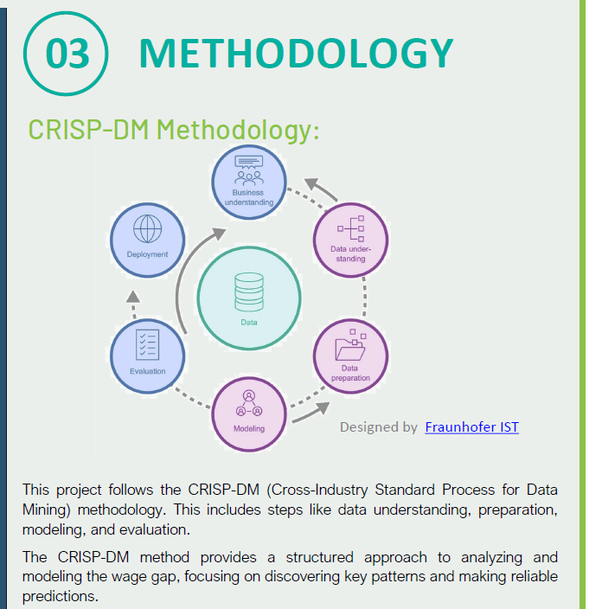
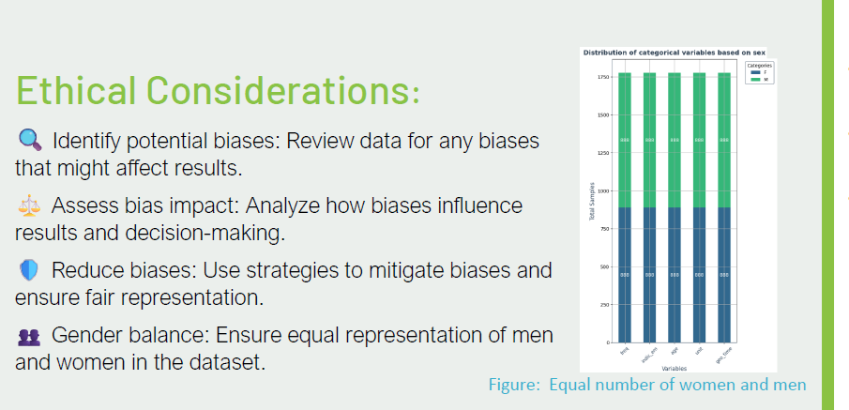
Notes:
Methodology: For this project, I used CRISP-DM process. This is a method used in data projects. It has steps like understanding data, preparing data, building models, and evaluating them.
You can see the diagram of CRISP-DM. Ethical considerations were also important. I reviewed the data for biases, assessed their impact, and used strategies to ensure fair representation of both men and women.

Slide 4

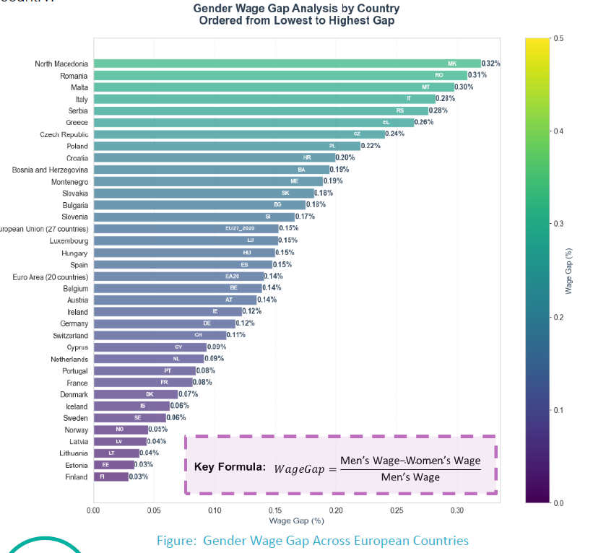
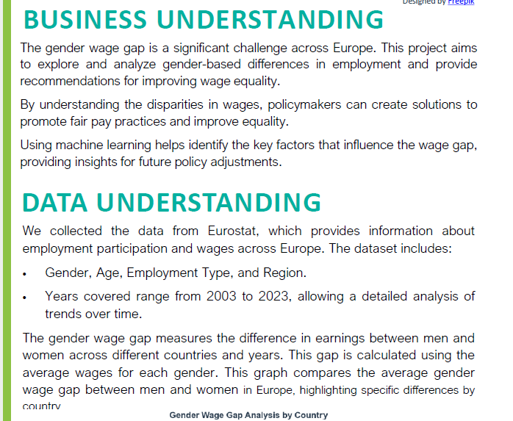
GENDER WAGE GAP
Designed by Freepik
Notes:
Business Understanding: The gender wage gap is a big problem in Europe. Understanding why it happens can help create fairer pay policies. This project looks at the differences in pay between men and women to help make better decisions for equality. Data Understanding: The data came from Eurostat. It has information on gender, age, job type, and region, from 2003 to 2023. The graph shows the gender wage gap in different countries. Darker colors mean a bigger gap. This helps us see which countries have the biggest differences in pay between men and women.

Slide 5
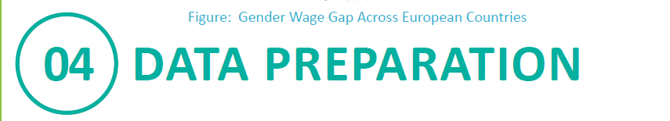
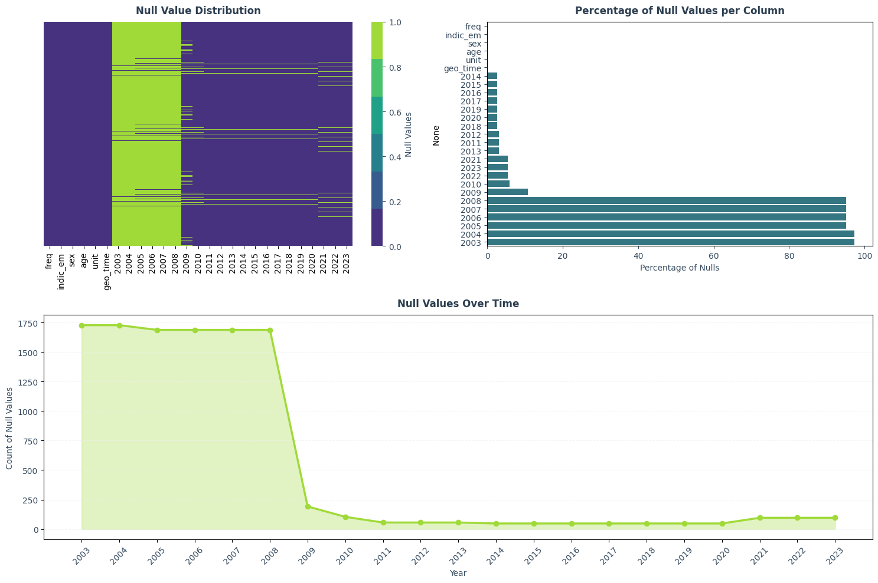
For data preparation, several important steps were taken:
Data Cleaning: Missing values were handled using linear interpolation to ensure data quality.
Feature Selection: Important features like age, employment type, and region were selected using correlation analysis.
Balancing the Data: The dataset was balanced using SMOTE to handle gender class imbalance.
Notes:
Data Preparation: To prepare the data. First, I cleaned the data. Some information was missing, so I used linear interpolation to fill in the gaps. Next, I selected the most important features, like age, job type, and region. Then, I balanced the data to have equal number of men and women using the SMOTE technique.

Slide 6
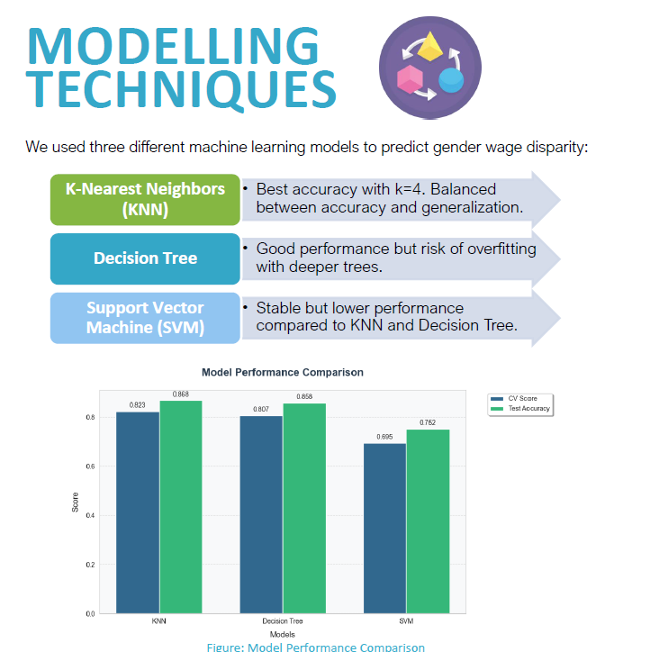
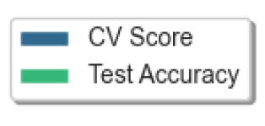
Notes:
Modeling Techniques: I used three models to predict the wage gap. The KNN model was the best. It had a good balance between accuracy and generalization. The Decision Tree model also worked well, but it sometimes overfitted the data. The Support Vector Machine (SVM) model was stable, but it was not as accurate (akiured). In the bar chart You can see a comparation (comparazon) of how accurate (akiured) is each models. KNN had the highest accuracy (akiurecy).

Slide 7
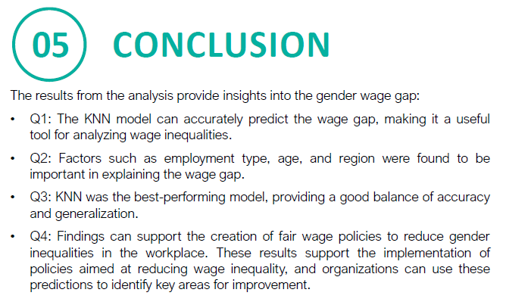
Notes:
Conclusion The project found important results. KNN was the best model to predict the gender wage gap. The analysis showed that age, job type, and region are important factors in explaining the wage gap. These findings can help create policies to reduce the wage gap and promote fairness in the workplace.
Thank You Thank you very much for listening to my presentation. I hope this project helps to better understand the gender wage gap and how we can reduce it. If you have any questions, please feel free to ask me now.

